Slide 1
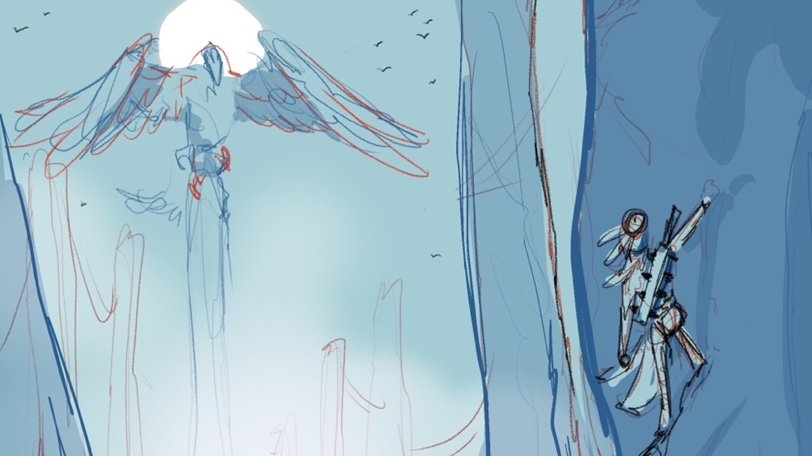
The Winds of Boriken
Paul Smith
David Monsegur
Fall 2021

Slide 2
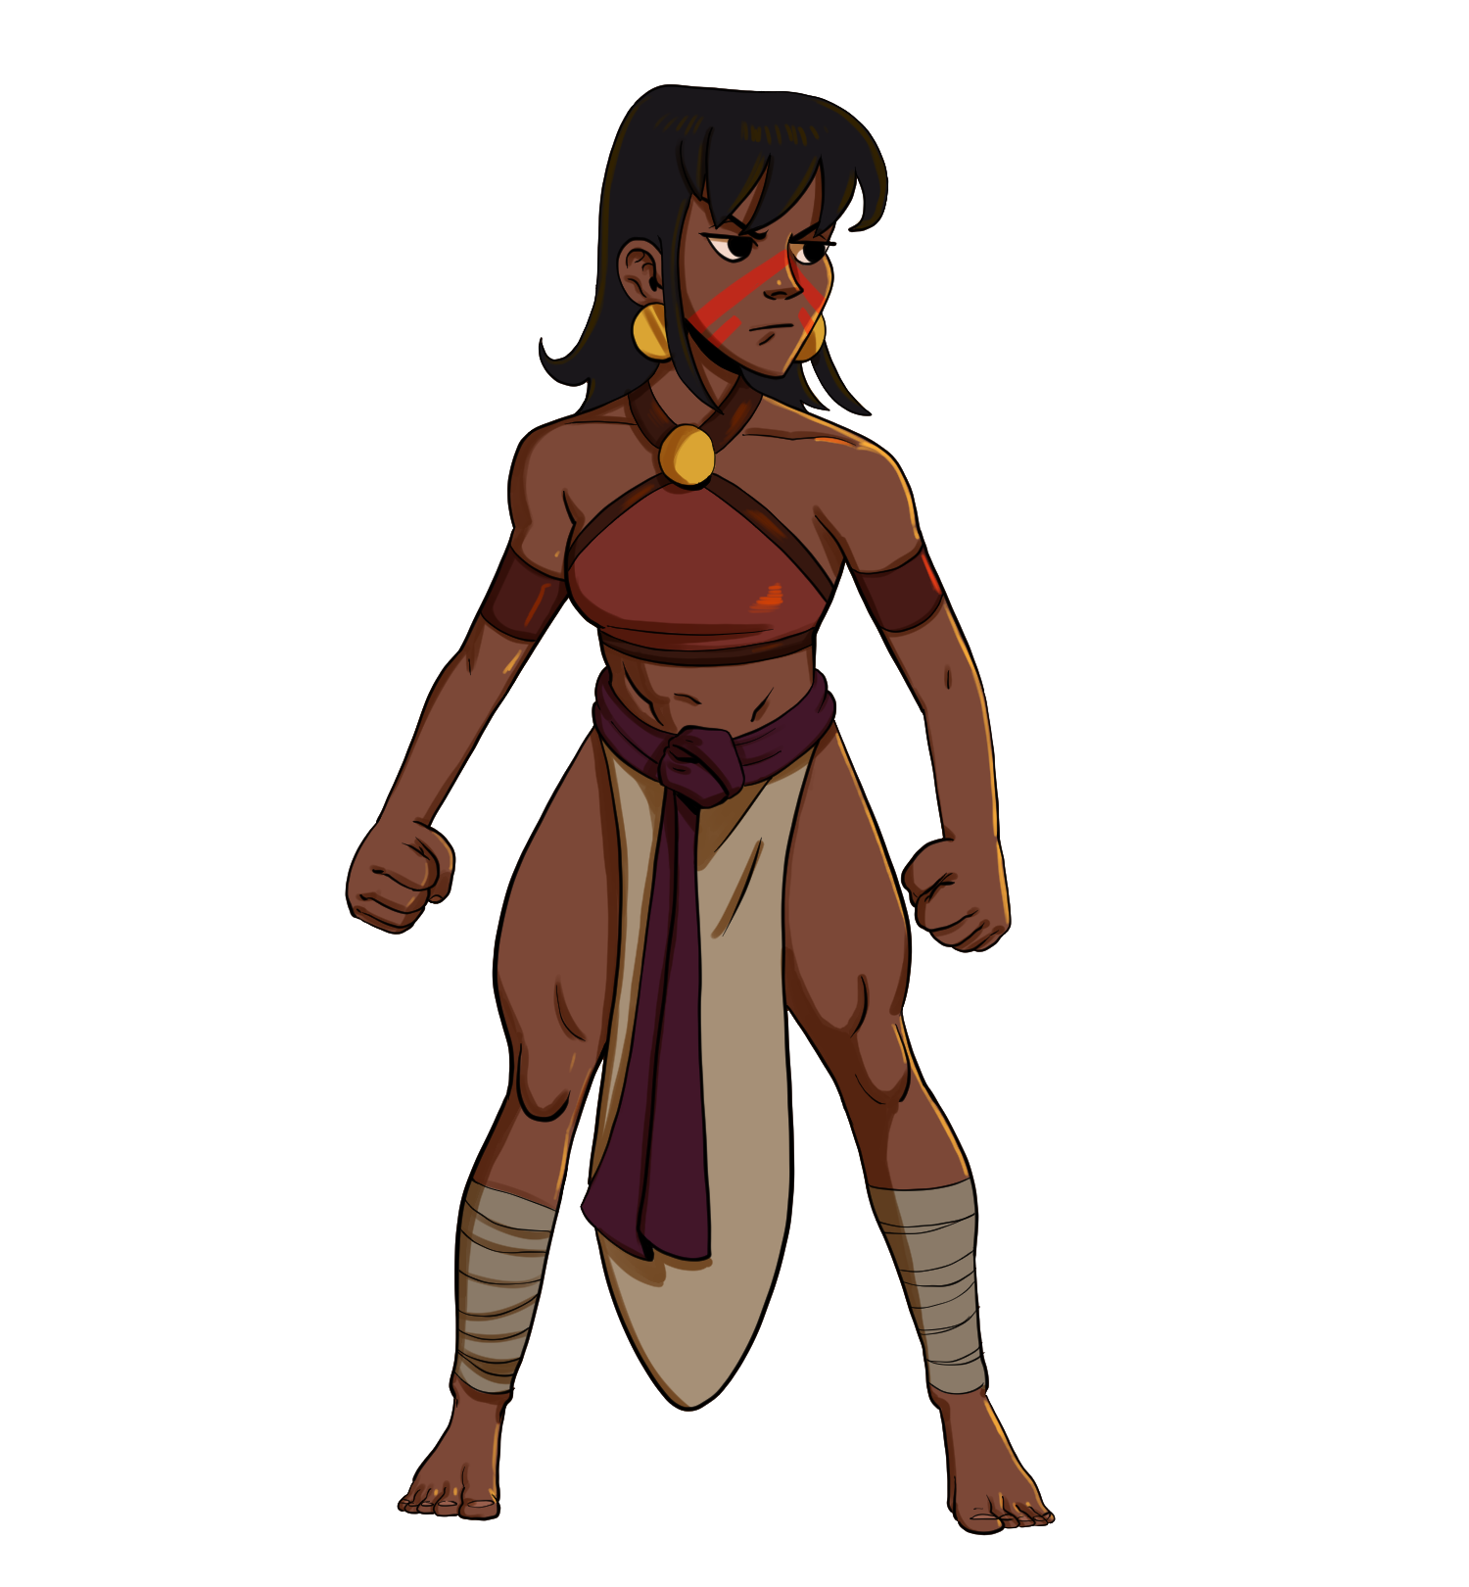
Motivation, Problem, Solution
Latino characters rarely feature in fantasy stories
Action games often portray women as goals to achieve
There is little education about the Taíno and their mythology
We’re making a Taíno inspired action game featuring a young woman as the protagonist

Slide 3
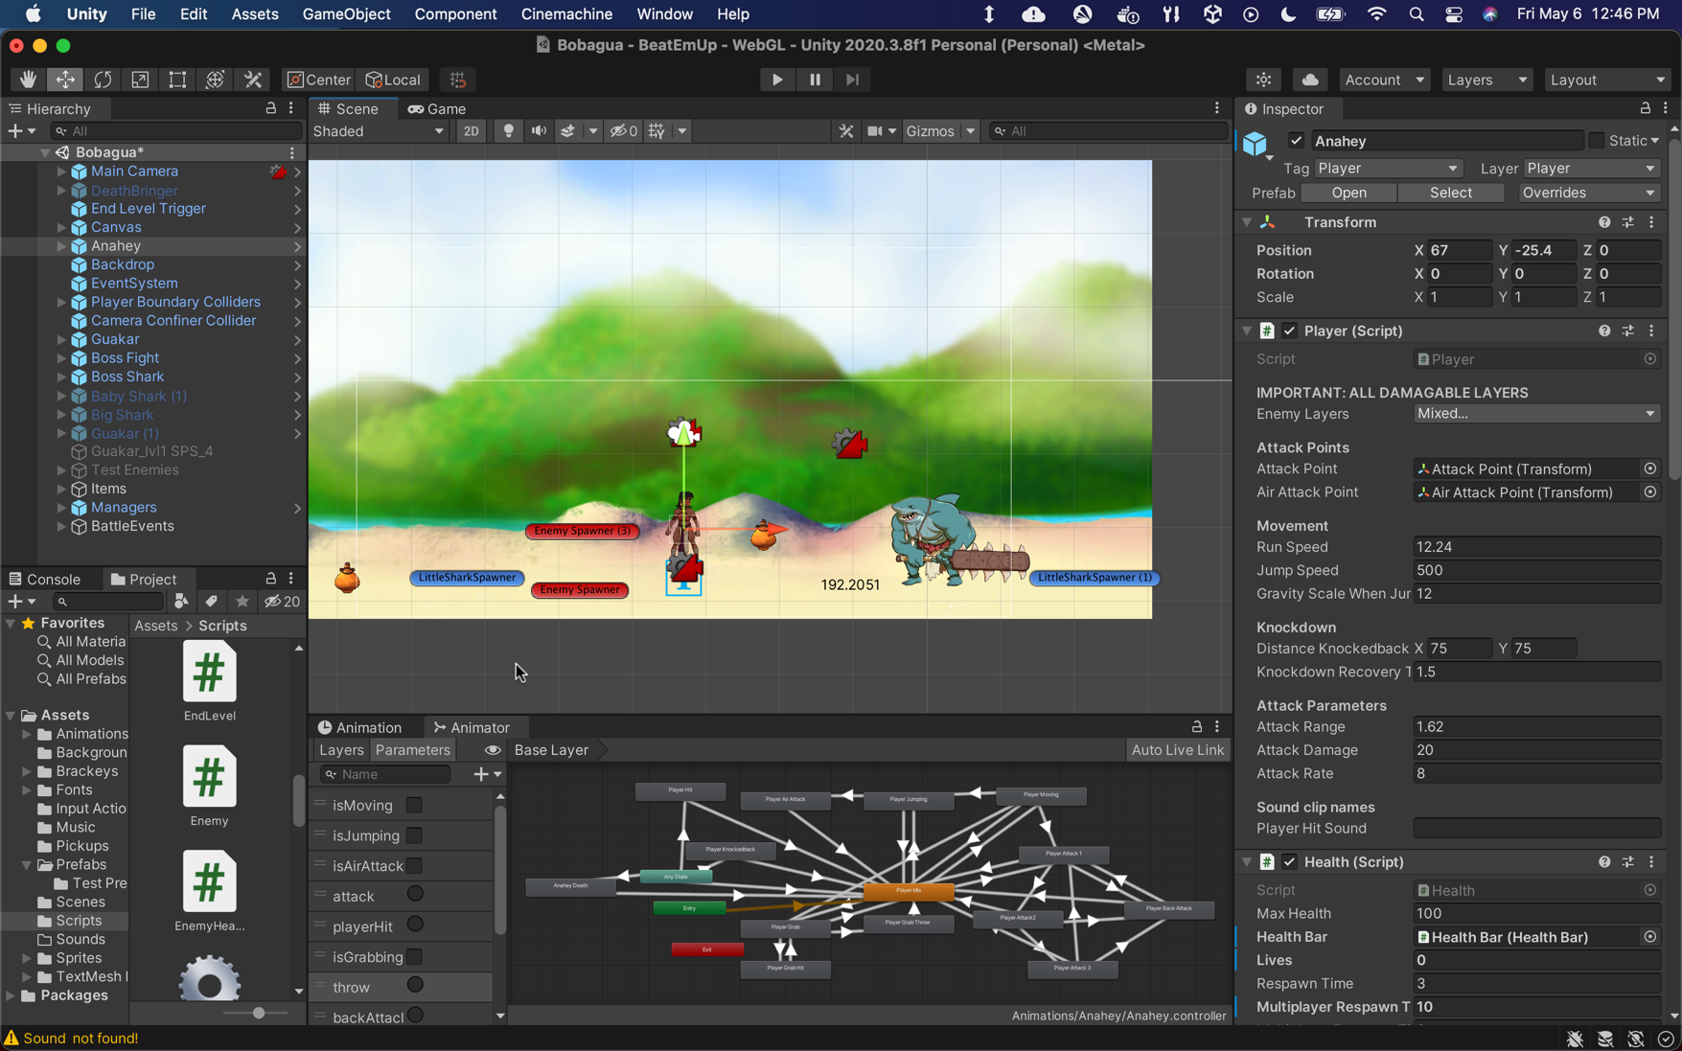
Tools
Engine: Unity (C#)
IDE: Visual Studio
Platform: Desktop
Can be embedded into website
Players will need a laptop or desktop with a browser that supports WebGL (Firefox, Chrome, Edge)

Slide 4
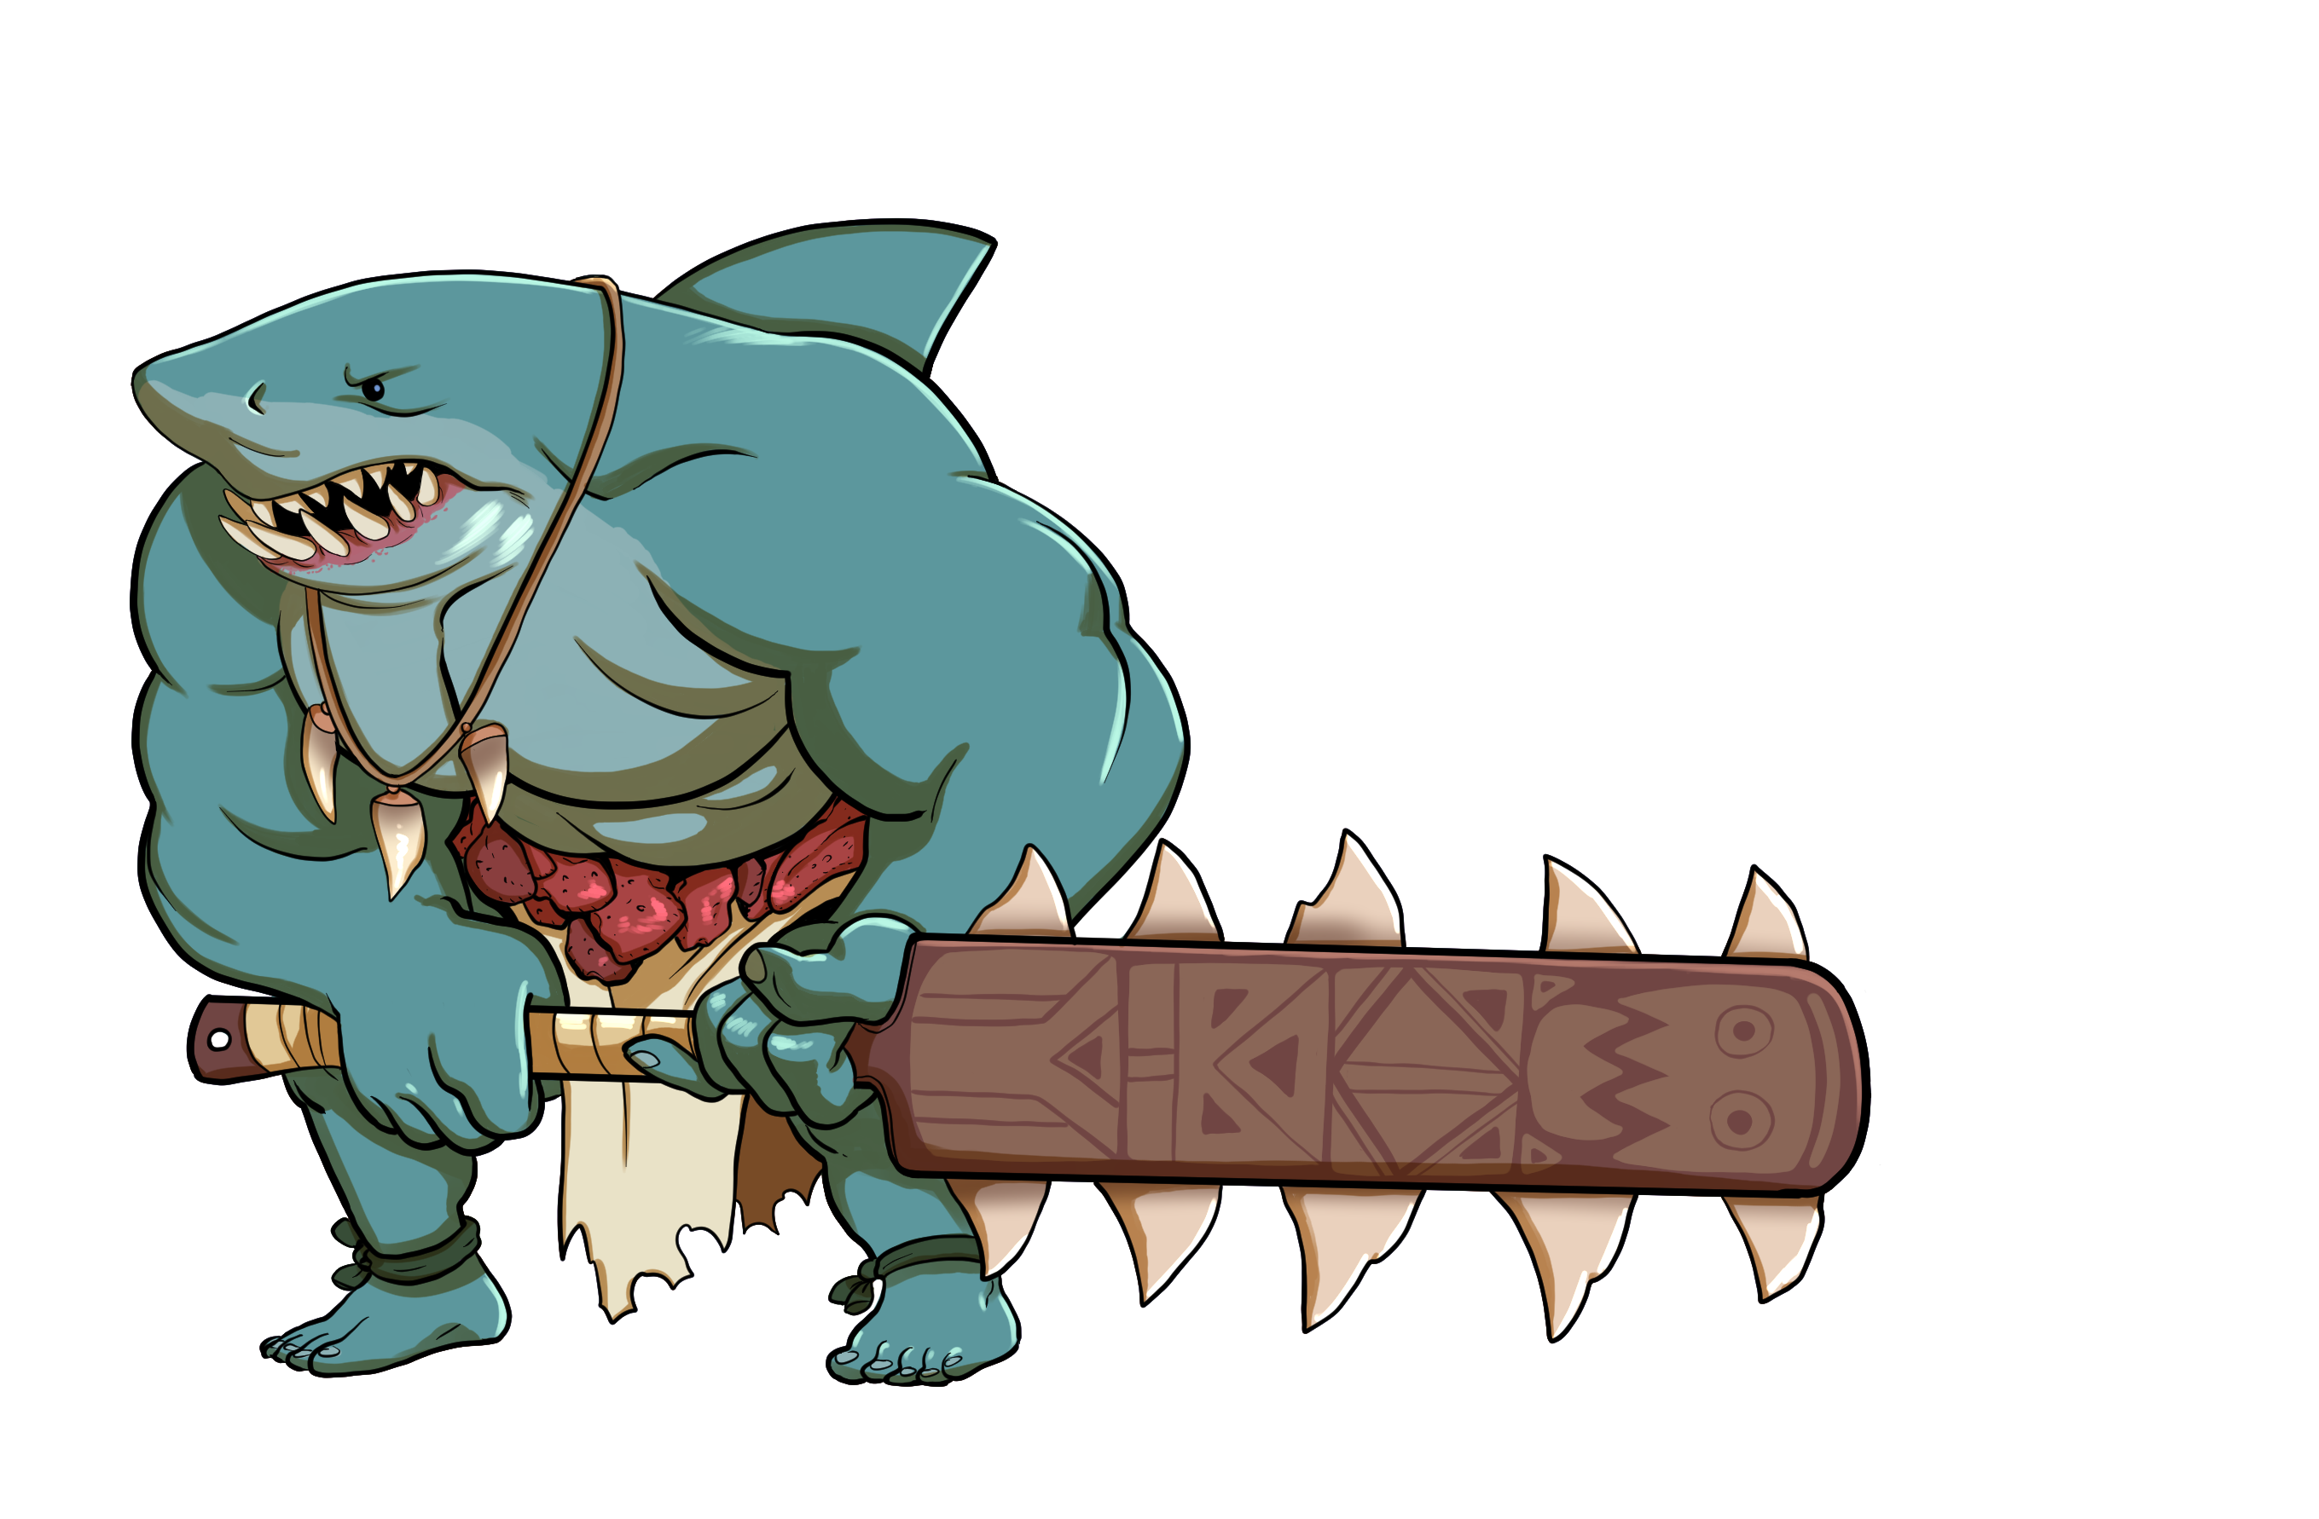
Functionalities
The player can:
Move in x and y directions
Jump
Jump attack
Combo attacks on ground
Change direction while attacking
Grab
Grab attack
Pickup health and score items
Die and respawn
Dialogue with friendly NPCs
Restart a level
Spawn a second player to play with
The game will keep track of
Player health, lives, and score
Number of enemies the player needs to to defeat before moving on
Level progress

Slide 5
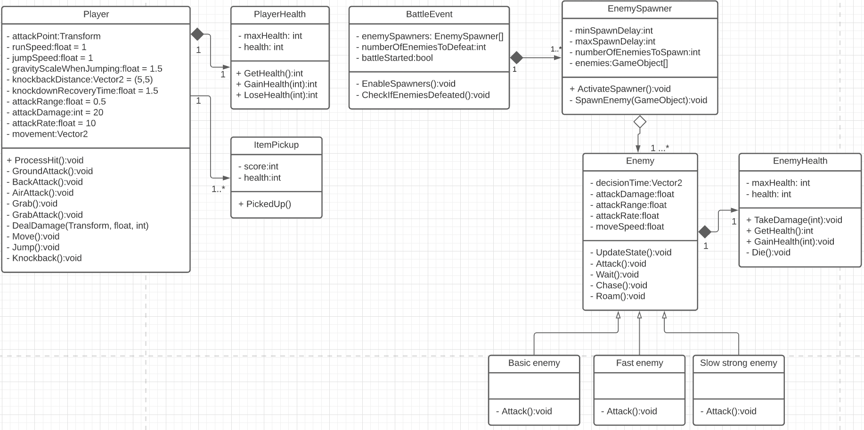
Data Structures
In Unity, every script defines a class.
Objects of those classes interacting make up the gameplay.

Slide 6
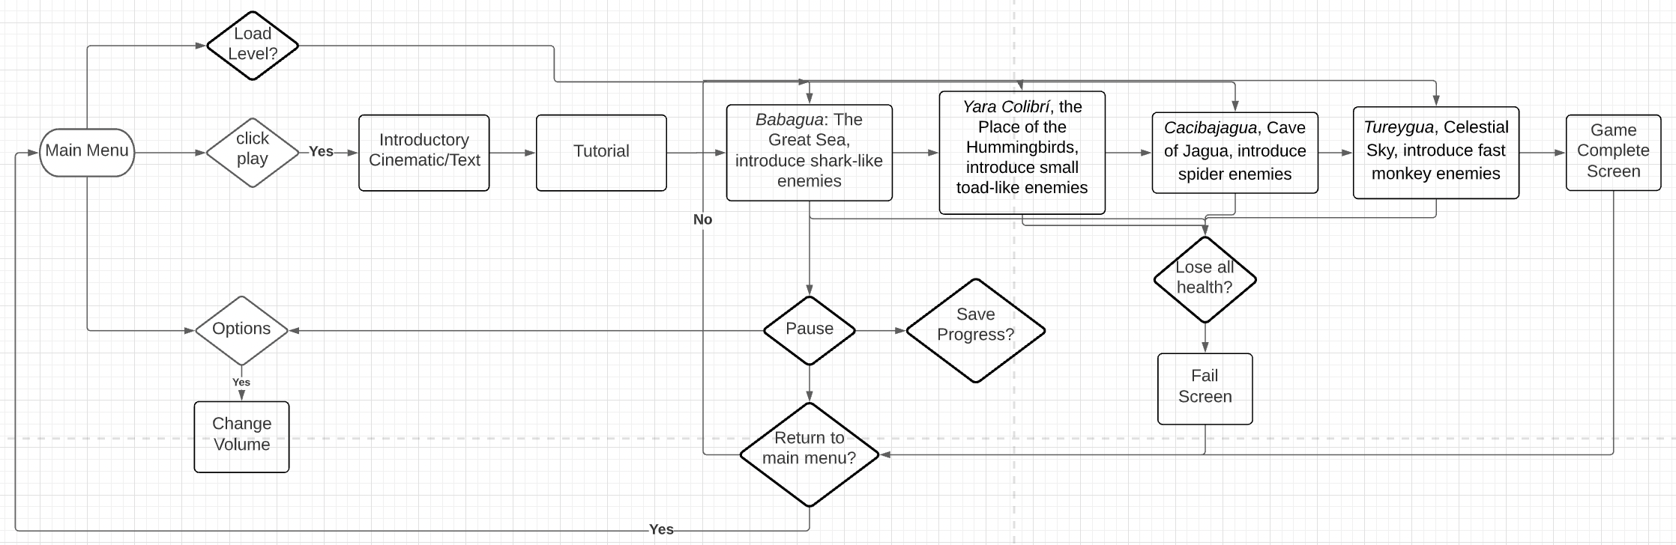
Flow Chart
The game is made up of four levels with multiple waves of enemies

